Slide 1
gosu-presentation
Helpful figures for understanding gosu

Slide 2
Game Development
With go, ebitengine

Slide 3
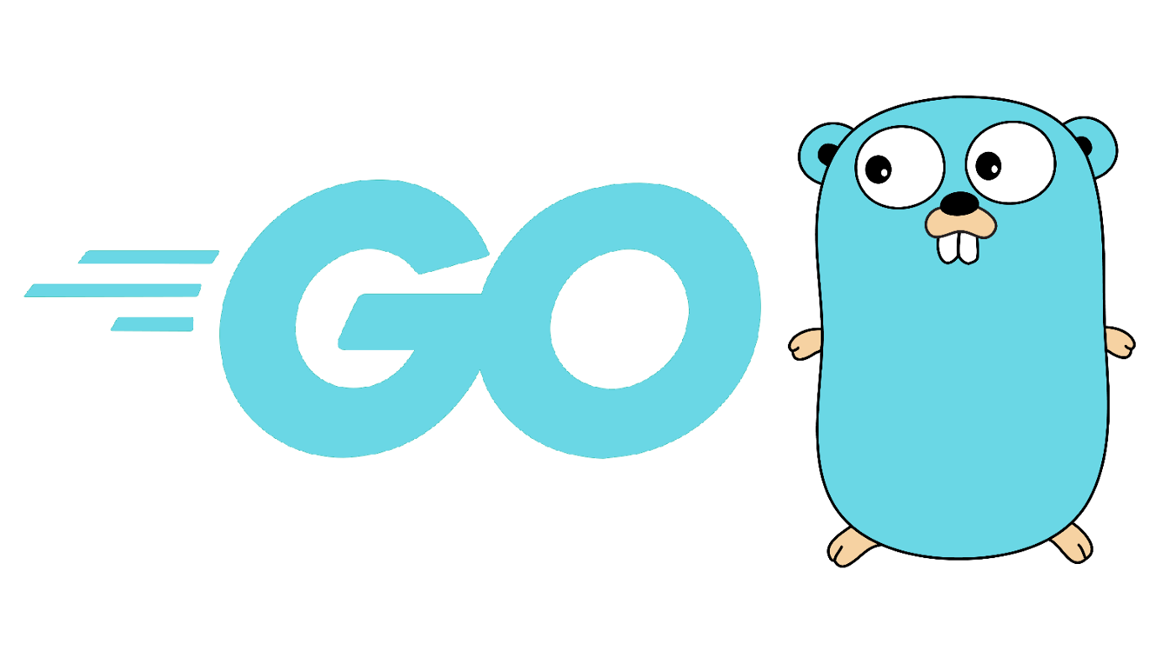
The Go Programming Language
Easy to learn
Minimum keywords
Simple syntax
hndada/go-tutorial: Go in an hour (github.com)
Strongly-typed Language
Powerful linter
Cross-compile
…
The Go Programming Language https://go.dev/

Slide 4
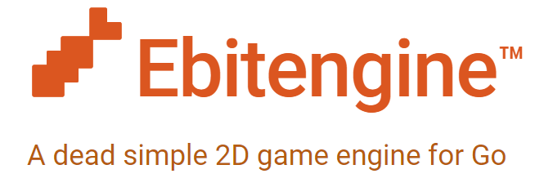
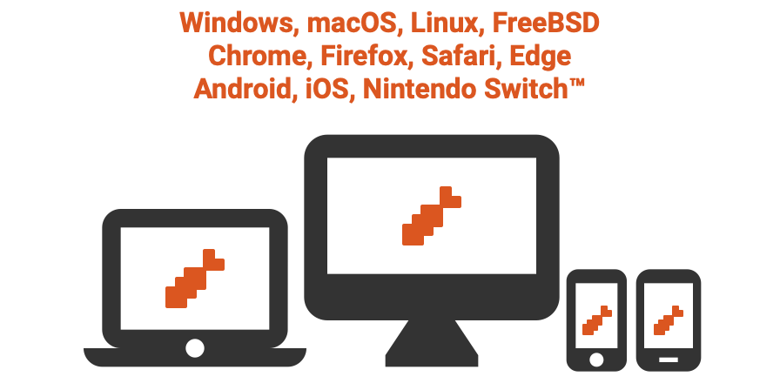
Ebitengine
Draw images with options
Translate
Scale
Rotate
Color
Fetch input
Play music
Ebitengine - A dead simple 2D game engine for Go https://ebitengine.org/

Slide 5
How Game Runs
Update the state
Fetch input
Various calculation (Mob HP, …)
Most of works go here
Draw the state
Frame Per Second (FPS)
Higher FPS makes the game look smoother
FPS is 60 in general

Slide 6
General
Select scene, Update() of play scene

Slide 7
Flow of gosu
Load settings, skin and music
Select a chart to play
Play a chart
Call NewScene()
Update()
Check Events (if music needs to start playing, if time is over, …)
Fetch Input
Judge and Score
Update Drawers
Return to Select scene

Slide 8
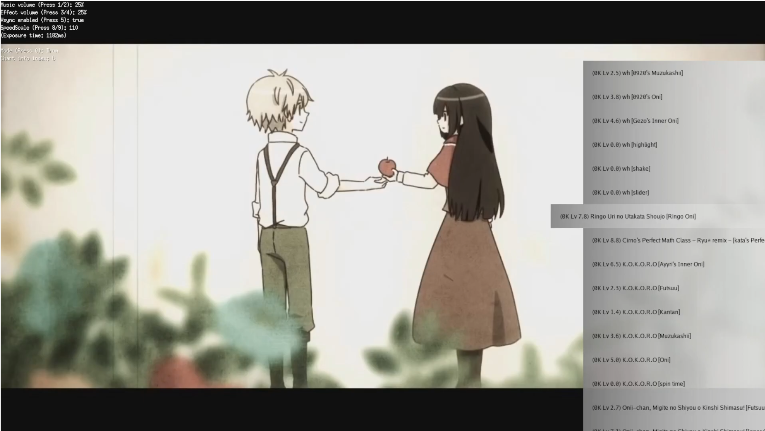
Select Scene
Chart Items
Background
Debug Print
Handlers
Selected Chart
Volume
Speed
Brightness
Mode
Sort by

Slide 9
Piano
Note, Judgment, Play Scene, Dancer

Slide 10
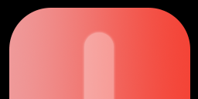
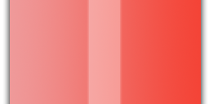


Piano: Note Type
Tail
Body
Head
Normal
Long

Slide 11
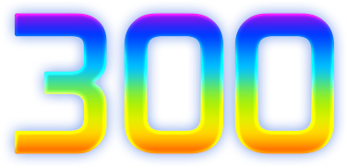
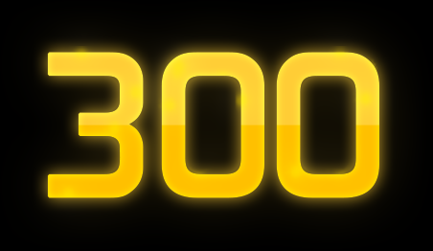
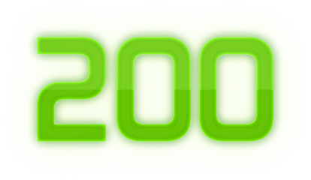
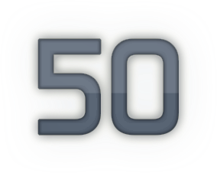

Piano: Judgment
Early
Late
Normal: Press the key
Tail: Release
Body: Keep pressing (no extra score)
Head: Press

Slide 12
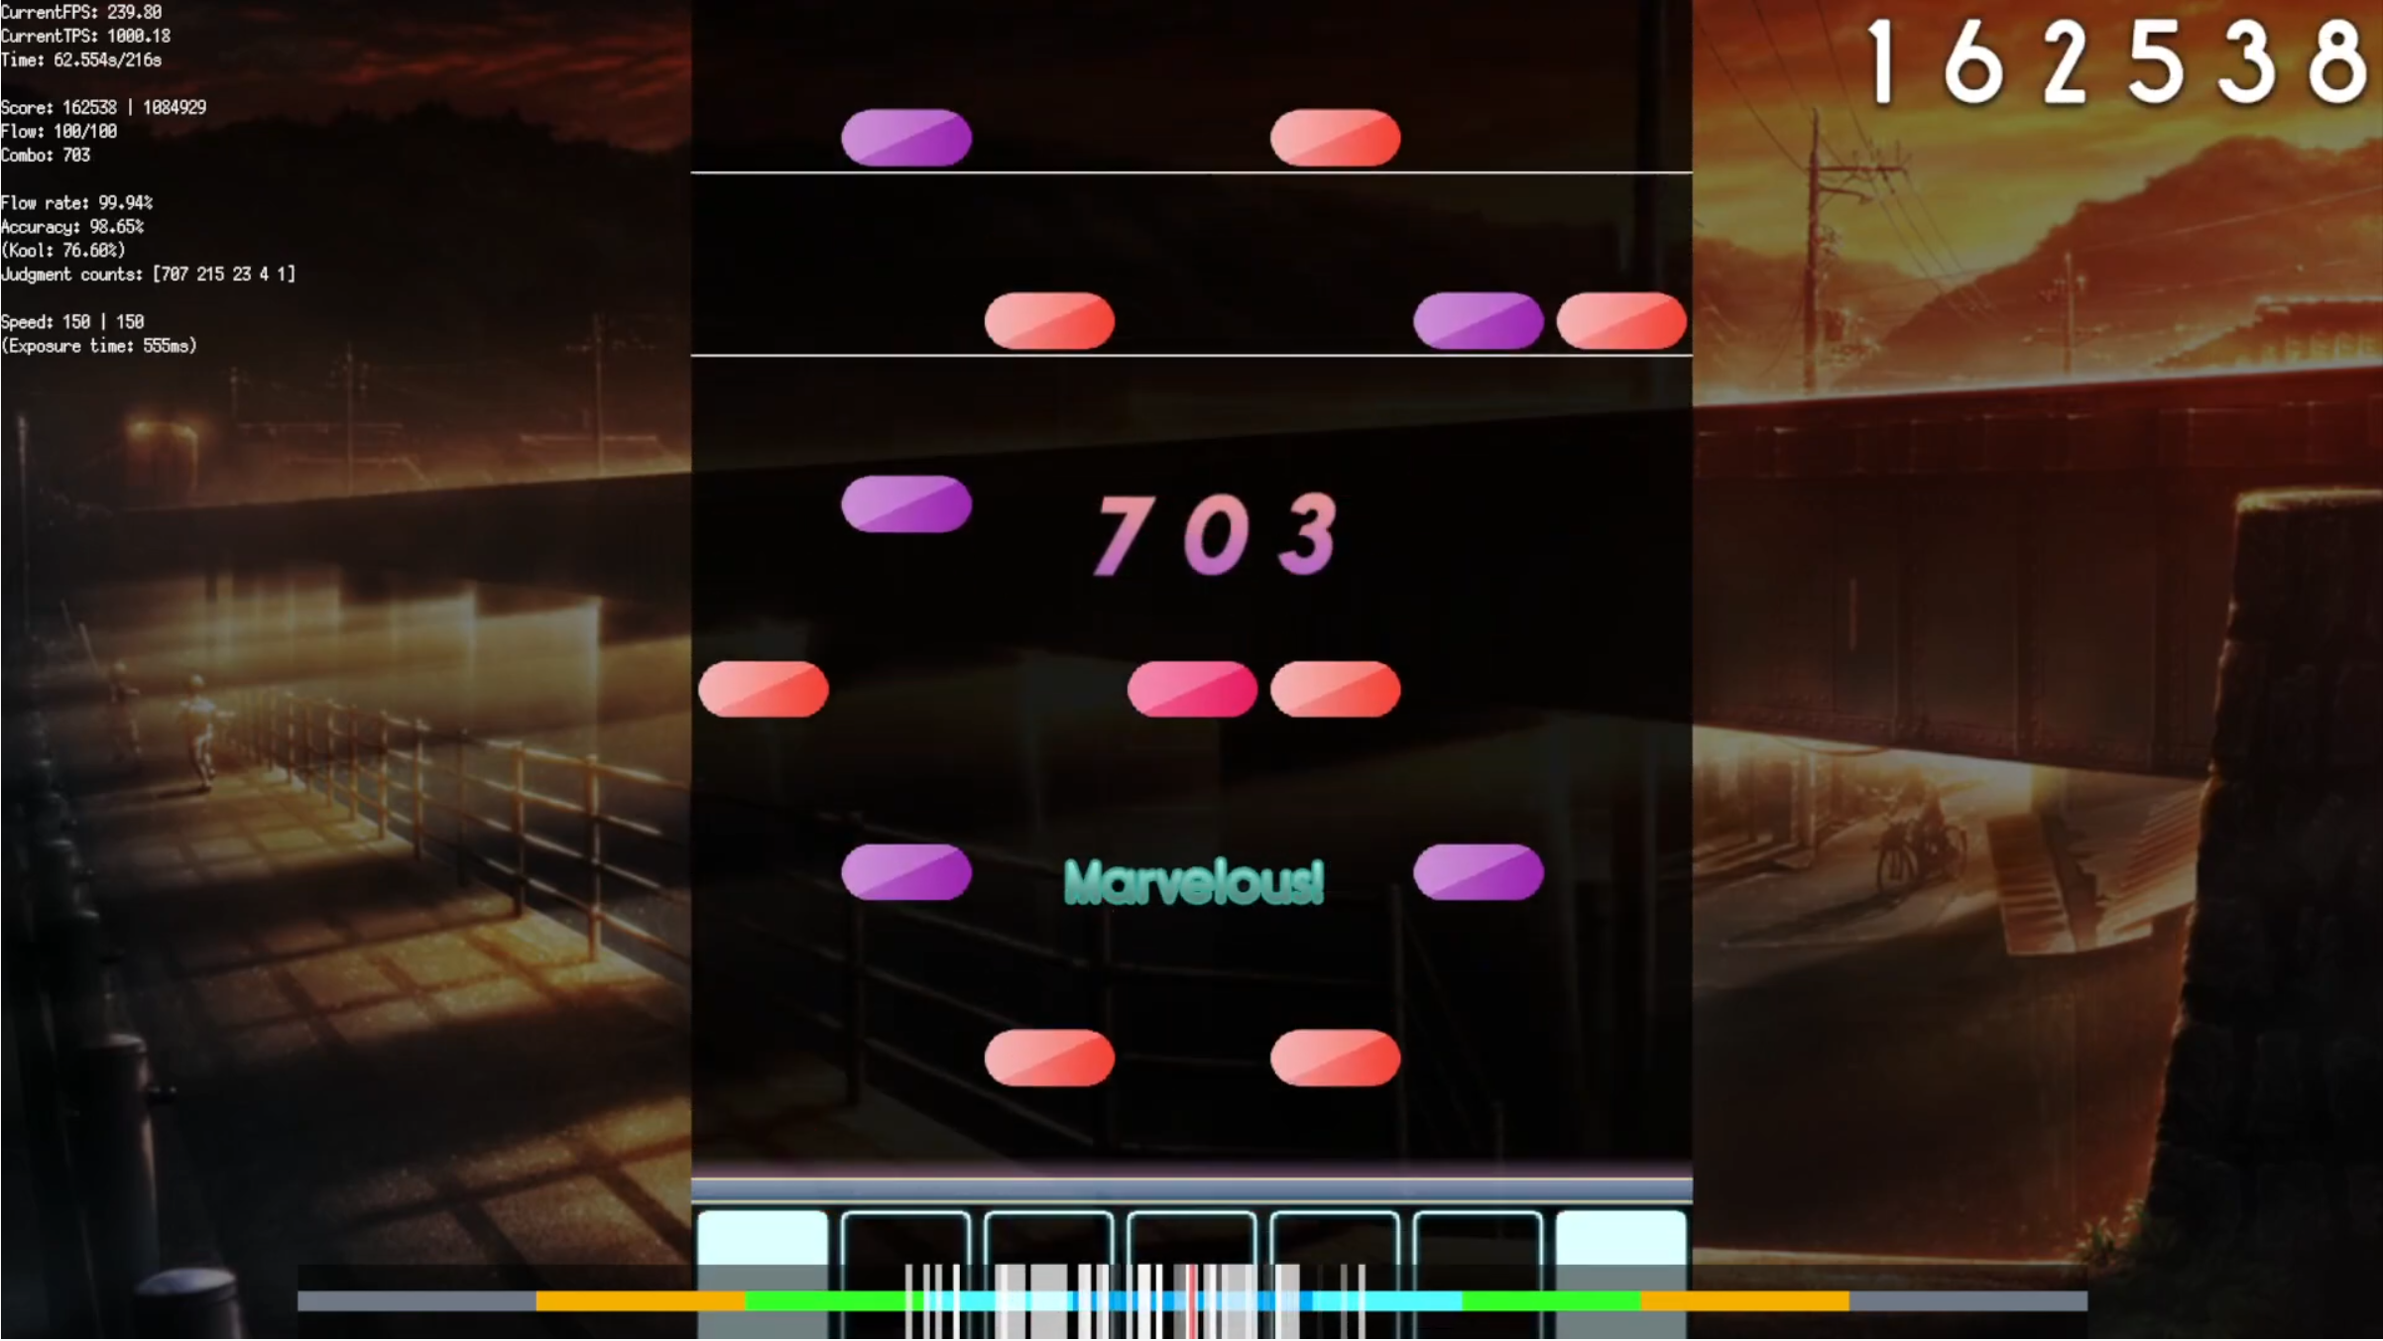
Piano: Play Scene (1)
Bar
Notes
Combo
Keys
Judgment

Slide 13
Piano: Play Scene (2)
Stage
Score
Background
Debug Print
Meter
(shows timing error)
Hint

Slide 14
Piano: Drawing Notes
Notes are drawn relative to Cursor
Cursor is fixed at screen
Speed
1.0x
2.0x
2.0x
Note Time
100ms
200ms
300ms
Note Position
100
200
400
Current Time
150ms
150 =100+(150–100)ms×1.0
Cursor Position

Slide 15
Piano: Drawing Notes
Notes are drawn relative to Cursor
Cursor is fixed at screen
Speed
1.0x
2.0x
2.0x
Note Time
100ms
200ms
300ms
Note Position
100
200
400
Current Time
250ms
300 =200+(250–200)ms×2.0
Cursor Position

Slide 16
Drum
Note, Judgment, Play Scene, Dancer

Slide 17





Drum: Note Type
Red
Shake
Blue
Dot
Roll
Regular
Big

Slide 18



Drum: Judgment for Regular Note
Regular
Score weights
100%
25%
0%
Early
Late

Slide 19


Drum: Judgment for Big Note
Big
Score weights
100%
25%
0%
Early
Late
50%
12.5%
0%
Early
Late
(hit one-side only)

Slide 20
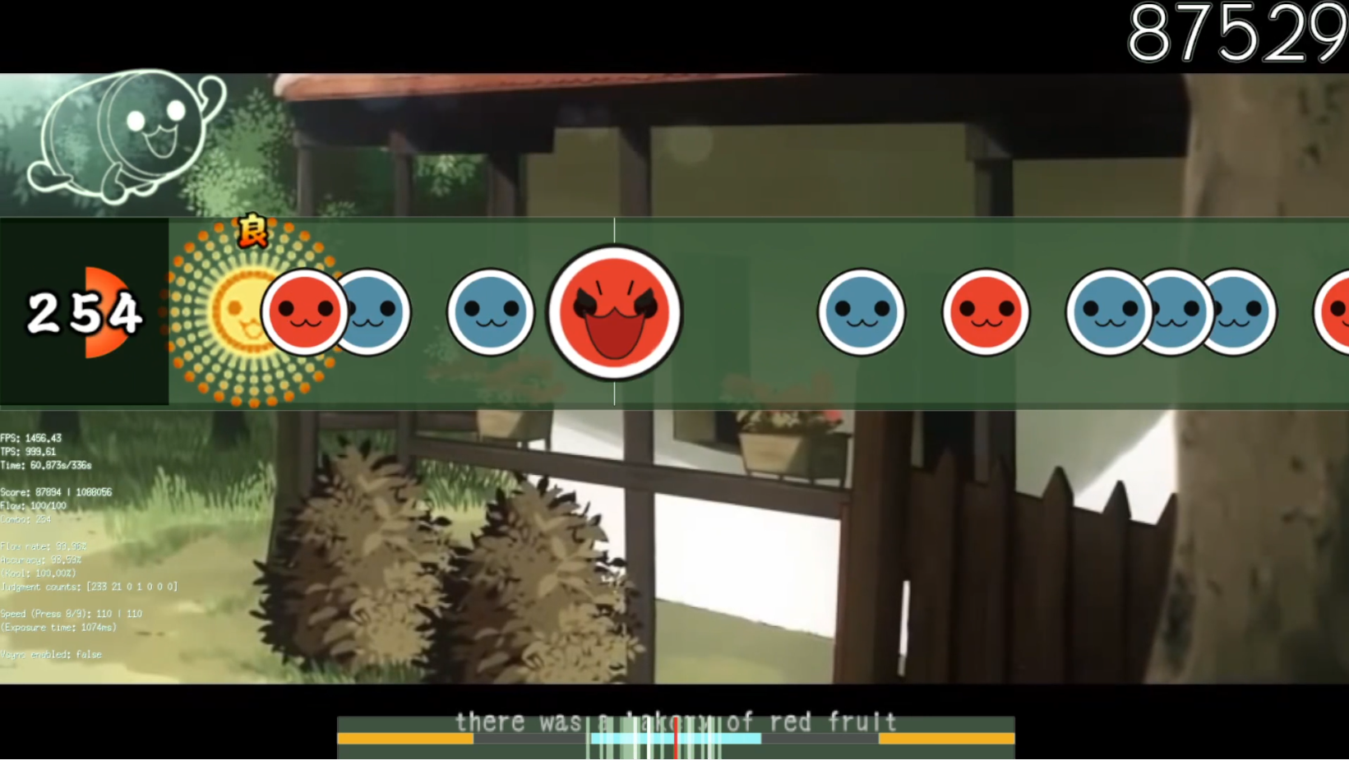
Drum: Play Scene (1)
Bar
(beat separator)
Score
Combo
Notes
Judgment

Slide 21
Drum: Play Scene (2)
Background
Dancer
Stage
Keys
(lights on if pressed)
Debug Print
Meter
(shows timing error)

Slide 22



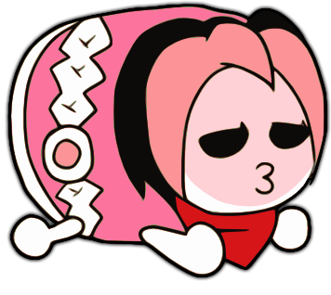
Drum: Dancer
Idle
High (when music is highlight)
Yes (when combo reaches 50, 100, 150, …)
No (when combo breaks)

Slide 23
Drum: Drawing Notes
func (n Note) Position(time int64) float64 {
return float64(n.Time-time) * f.Speed
}
func (d NoteDarwer) Draw(screen *ebiten.Image) {
if note.Marked {
op.ColorM.Scale(1, 1, 1, 0) // Invisible
}
note.Move(position, 0)
note.Draw(screen, op)
}

Slide 24
Extra
Visual effect: scroll effect on score

Slide 25
Scroll Effect on Score
type Delayed struct {
Delayed float64
Source float64
Feedback float64
}
func (d *Delayed) Update(v float64) {
d.Delayed += (d.Source - d.Delayed) * d.Feedback
}
// The formula is to make speed of transition constant regardless of TPS.
func (d *Delayed) setSource(v float64) {
const tick = 800
d.Source = v
d.Feedback = 1 - math.Exp(-math.Log(d.Source - d.Delayed)/float64(tick))
}

Slide 26
Example: Scroll Effect on Score
Tick | Delayed
0 | 10000
1 | 11423
2 | 12644
3 | 13690
4 | 14588
5 | 15358
6 | 16019
7 | 16585
8 | 17071
9 | 17488
10 | 17846
11 | 18152
12 | 18415
13 | 18641
14 | 18834
15 | 19000
16 | 19142
17 | 19264
18 | 19369
19 | 19459
20 | 19536
21 | 19602
22 | 19659
23 | 19707
Delayed | 10000
Source | 20000
Tick | 60
Feedback | 0.142304

